Slide 1
Research Project
Sources

Slide 2
Agenda
Working with Bias
Non-Text Sources
Conducting Interviews

Slide 3
Midterm
Plus/Delta

Slide 4
Learning Activity:
a list of at least 3 sources in MLA format
Describe the perspectives each source provides
One idea for your interview or observation
Three possible research questions for that source

Slide 5
Finding sources with different perspectives
Add “benefits” or “critiques” to your general searches
Follow one source to another
Identify one or two “core sources” or “anchor sources”
Use keywords or phrases from those sources in your search
Ask for help!
Wren does this for her job, basically
Your interview/observation subject might have suggestions
Ask your peers

Slide 6
Reading Scholarly Articles
Read the abstract to decide if it’s worth your time
Find the research questions, aims, or hypotheses to get a framework
Skip down to the Results and Discussion (last two sections)
Try finding the following:
What is the situation?
What is the problem?
What is the solution?

Slide 7
What about non-text sources?
Video Essays
Podcasts
Documentaries
News broadcasts
TedTalks
Infographics
Check for:
Credibility
Accuracy
Reasonability
Support

Slide 8
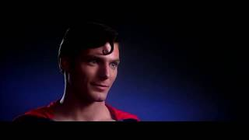
Link

Slide 9


Slide 10
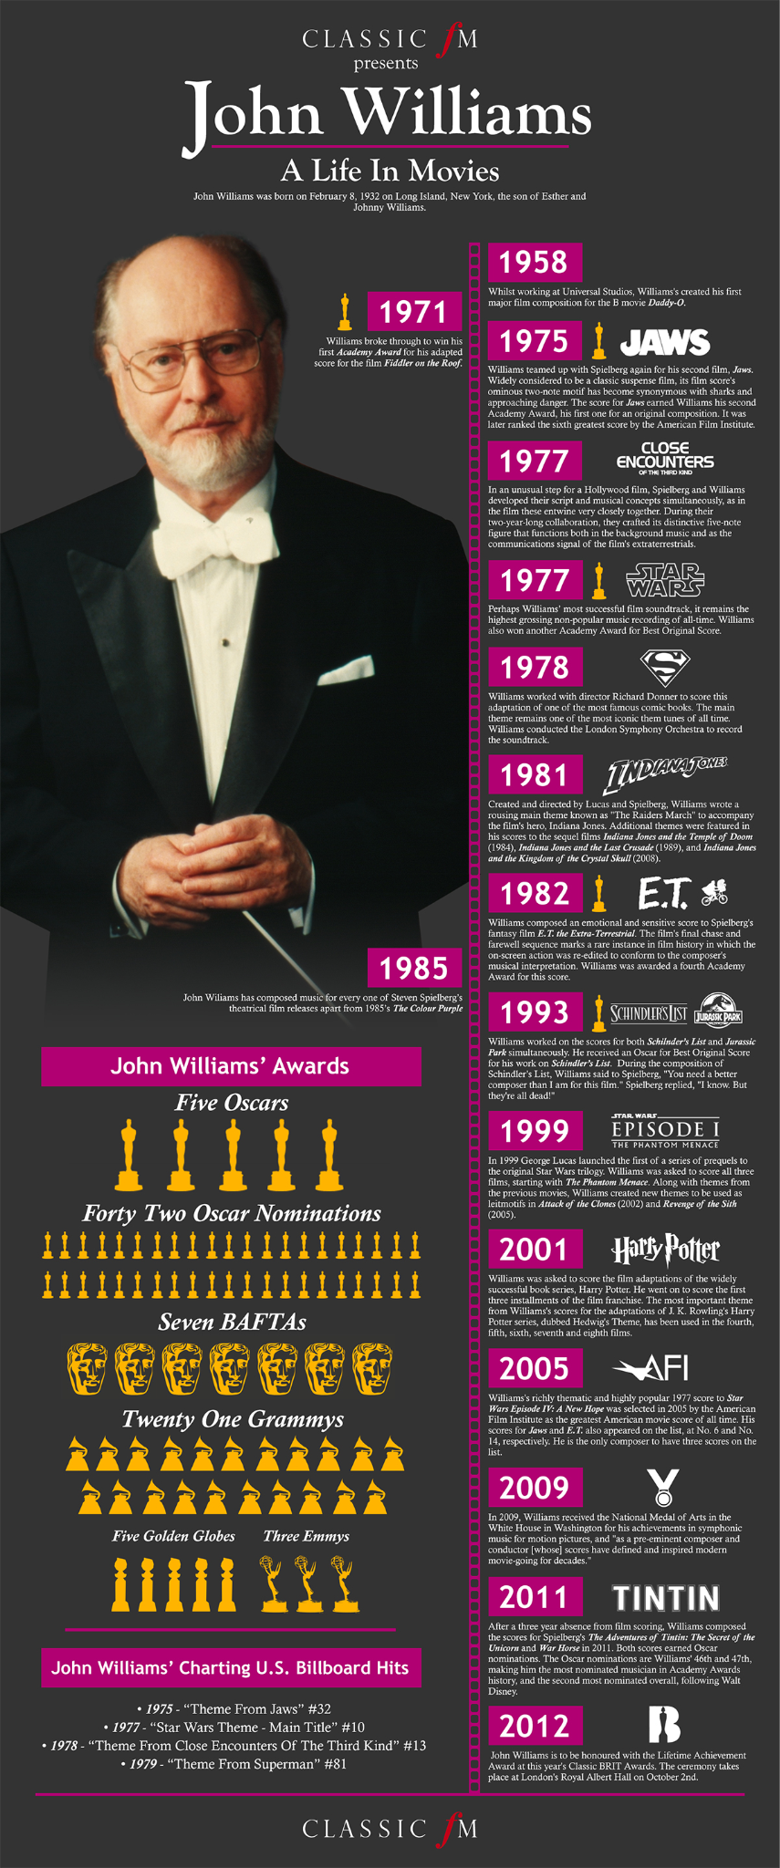

Slide 11
Asking for an interview…
Hello [Name],
I am writing a research paper for a class at Iowa State University and I would love the opportunity to interview you about your experience with [topic].
The interview would take no more than 30 minutes and I would be happy to meet with you [in-person/online]. Below are some times that would work best for me.
Please let me know if you would have time for this interview and, if so, what times work well for you. Thank you for your time!
Best,
[Your name]
Some people appreciate it when you provide the interview questions in advance!

Slide 12
How to Write Interview Questions
Identify the focus of your interview
Brainstorm things you want to know about that topic
What got them involved in the topic?
What challenges did they face?
What changes are happening, good or bad?
Ask varied questions, but keep them open-ended
Ask for stories about their work
Let subjects correct misconceptions or provide opinions
Ask about the subject’s past and future

Slide 13
Asking to observe a gathering…
Hello [Name],
I am writing a research paper for a class at Iowa State University over [topic] and I would love the opportunity to observe [organization, committee, etc.] during one of your meetings.
If possible, I would love to record the meeting for accurate note-taking. However, if this is not possible, I would be happy to just take notes based on what I’ve observed.
Please let me know if I would be able to sit in on a meeting and, if so, when the best time to meet would be. Thank you for your time!
Best,
[Your name]

Slide 14
How to Prepare for Observations
Create a system for note-taking even if you’re recording
Make a list of questions you hope to answer through the observation
Ex. “What do they see as most important?”
Ex. “What initiatives are they working on right now?”
Observe reactions, tone, handouts, etc. as well as what’s directly stated
Just make sure it’s clear this is your perception of what happened in the notes :)

Slide 15
For both interviews and observations…
Don’t be afraid to email with follow-up questions or clarifications
Make sure you email one last time when you’re done, thanking them for their time
Optional: Send them your final paper in the thank you email so they can see where they fit into the project
Only cite direct quotes if you’re confident they’re accurate, otherwise paraphrase (still needs a parenthetical)

Slide 16
Citing Interviews and Observations
Interview:
Smith, Jane. Personal interview. 19 May 2024.
[Name of person being interviewed]. Personal interview. [Date interview was
conducted].
* The date should be the date of their response, if completed asynchronously
Observation:
Graduate and Professional Student Senate. August Meeting. Observed by Wren
Bouwman on 3 October 2025, Iowa State University.
[Name of organization]. [Title of meeting]. Observed by [your name] on [date observed],
[location].

Slide 17
Questions to ask for each source:
Does this present a new perspectives, enhance a perspective in another article, or repeat information?
Who is the audience? Experts? Laypersons?
What quotes provide especially strong evidence, either though research, statistics, or personal experiences?

Slide 18
Learning Activity:
a list of at least 3 sources in MLA format
Describe the different perspectives in 2-3 sentences each
One idea for your interview or observation
Three possible research questions for that source

Slide 19
Thursday Agenda:
Overview of Community Capital Framework
Worksheet - Group Work
Close Reading of Emery & Flora
Worksheet - Individual Work

Slide 20
When you think about what makes a community strong or successful, what comes to mind?

Slide 21
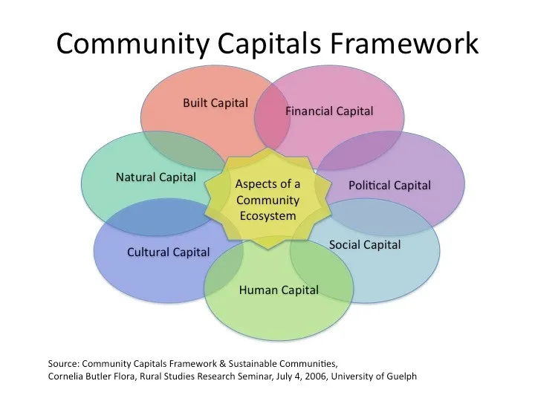
We’ll follow along with Part 1 of your worksheet!
Notes:
So when we think about problems and solutions, we need to look at what resources are being strained and what resources aren’t being addressed.

Slide 22
Natural Capital
Environment, land, water, air, and natural resources
Ex. Fast Fashion: Cotton fields, water for dyeing and washing textiles, synthetic materials derived from petroleum, farmland used for textile crops

Slide 23
Cultural Capital
Values, traditions, heritage, ways of knowing
Ex. Fast Fashion: Global trends; influencer culture and fashion cycles; aesthetic values tied to social status and identity; traditions of dress and beauty standards.

Slide 24
Human Capital
Education, skills, health, leadership, creativity
Ex. Fast Fashion: Laborers’ skills in sewing and garment assembly; designers’ creativity and technical knowledge; marketing

Slide 25
Social Capital
Access to power, voice in decision-making, influence
Ex. Fast Fashion: Networks between suppliers, manufacturers, and retailers; relationships between fashion influencers and followers; community groups that share, swap, or donate clothes; trust among brand consumers

Slide 26
Political Capital
Access to power, voice in decision-making, influence
Ex. Fast Fashion: Trade policies regulating imports and exports; labor laws; environmental regulations

Slide 27
Financial Capital
Money, investments, credit, infrastructure funding
Ex. Fast Fashion: Corporate profits; investor funding for major brands; consumer spending on clothing; global economic systems that keep prices low

Slide 28
Built Capital
Physical infrastructure (roads, buildings, technology, housing)
Ex. Fast Fashion: Factories, warehouses, ports, and shipping infrastructure; retail stores and online sales platforms; textile mills; machinery for production; digital infrastructure that enables global e-commerce

Slide 29
Where does your research come into play?
Let’s see CCF in action!

Slide 30
In groups of 2-3
Open the file in the Week 7 Module called “EmeryFloraSpiralingUp2006”
Give each group member a role:
Cartographer
Evaluator
Connector
Practice your skimming skills and take 5-10 minutes to read the article.
Discuss your roles (on the next slide)

Slide 31
🗺️ The Cartographer
Your Goal: Identify and describe the seven community capitals and how they interact in the case study.
While You Read:
Highlight where each capital is defined (natural, cultural, human, social, political, financial, built).
Note examples from Valley County that show these capitals working together.
Sketch or describe the “spiraling-up” model. How does one capital strengthen another?
After Reading:
Which capital seems most central to the authors’ story?
How does social capital serve as a starting point for change?
🧭 The Evaluator
Your Goal: Examine how the authors make and support their claims about community transformation.
While You Read:
Underline phrases that describe evidence (interviews, data, field observations).
Identify the main argument. What are they claiming about “spiraling up”?
Notice how they organize their analysis of the HomeTown Competitiveness program.
After Reading:
How do they use the CCF to explain why change happened, not just that it did?
What makes their argument credible or convincing?
🌍 The Connector
Your Goal: Connect the ideas in the article to a contemporary issue or your own research topic.
While You Read:
Highlight examples that remind you of other community challenges (e.g., housing, sustainability, education).
Think about “spiraling up” and “spiraling down”. Where do you see those patterns today?
After Reading:
Which capitals seem most relevant to your research topic?
How might you use the CCF to analyze the systems or relationships shaping your issue?

Slide 32
In your research project, consider how you can use capitals to talk about spiraling up or spiraling down

Slide 33
Writing Check-in
By now you should know:
Your topic
A few useful sources
Language to talk about problems and solutions
Which means you can start:
Reading sources in-depth
Taking notes on similarities and differences between sources
Contacting your local sources for observations/interviews

Slide 34
Next week:
Comparing and Contrasting
Organizing your argument
Reminder: Week 9 (October 21 and 23) will be asynchronous)

